Slide 1

Joint Modeling of Temporarily Overlapping Responses
Matthew Burns

Slide 2
Overview
Previous Work and Background
Event Related Potential Regression
Experimental Validation
rERP Toolbox Walkthrough

Slide 3
Previous Work
H. Hinrichs, M. Scholz, C. Tempelmann, M. G. Woldorff, A. M. Dale, and H. J. Heinze, "Deconvolution of event-related fMRI responses in fast-rate experimental designs: tracking amplitude variations," Journal of Cognitive Neuroscience, vol. 12, pp. 76-89, 2000.
Smith, Nathaniel . “Scaling Up Psycholinguistics”. Dissertation, University of California, San Diego. 2011.
C. R. Pernet, N. Chauveau, C. Gaspar, and G. A. Rousselet, "Limo EEG: a toolbox for hierarchical linear modeling of electroencephalographic data," Computational intelligence and neuroscience, vol. 2011, p. 3, 2011.
M. D. Burns, N. Bigdely-Shamlo, N. J. Smith, K. Kreutz-Delgado, and S. Makeig, "Comparison of Averaging and Regression Techniques for Estimating Event Related Potentials," presented at the 2013 IEEE Engineering in Medicine and Biology Conference. 2013.

Slide 4
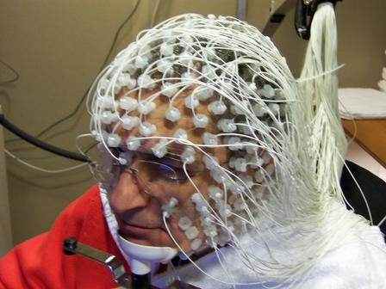
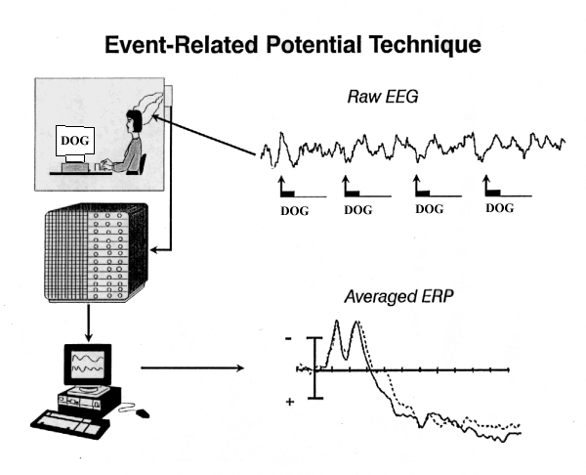
Background
ERP

Slide 5
Averaged Event Related Potential
Notes:
Vertical cascade

Slide 6
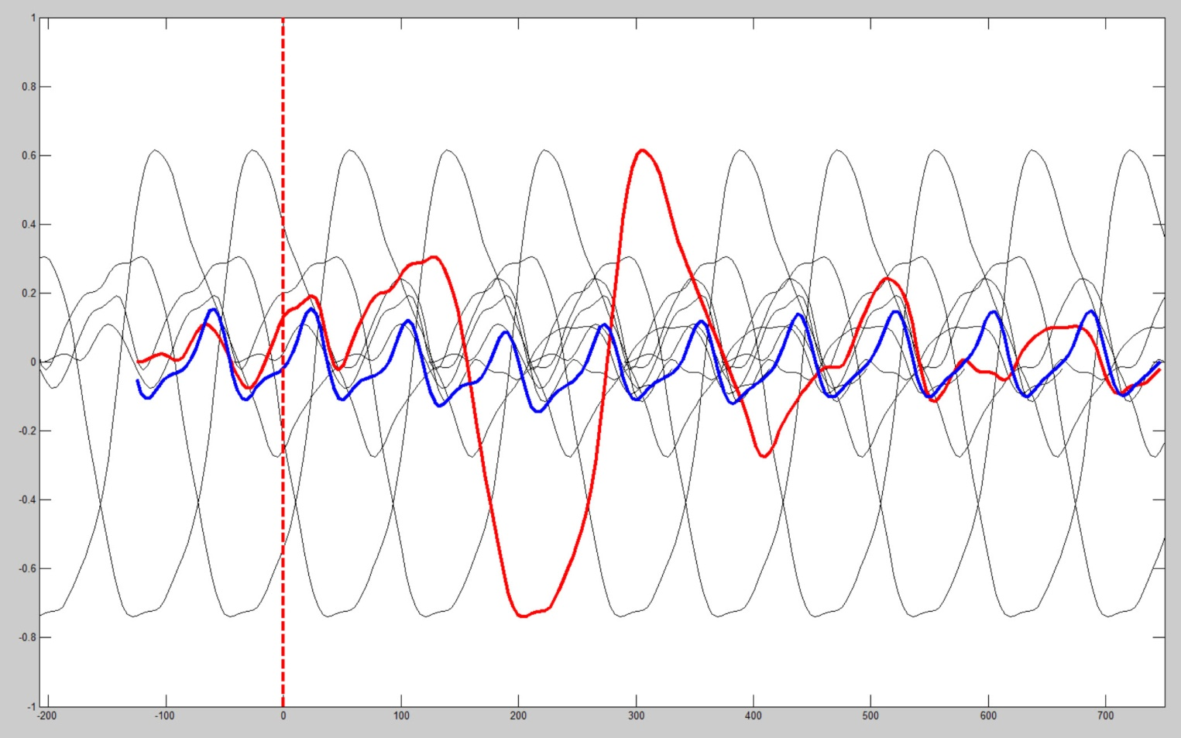
A Problem With Averaging
Notes:
Add dog tags

Slide 7
Linear Time Invariant Model
X₁[n]
h₁[n]
Σ
y[n]
X₂[n]
h₂[n]
X₃[n]
h₃[n]
X_{n}[n]
h_{n}[n]
e[n]

Slide 8
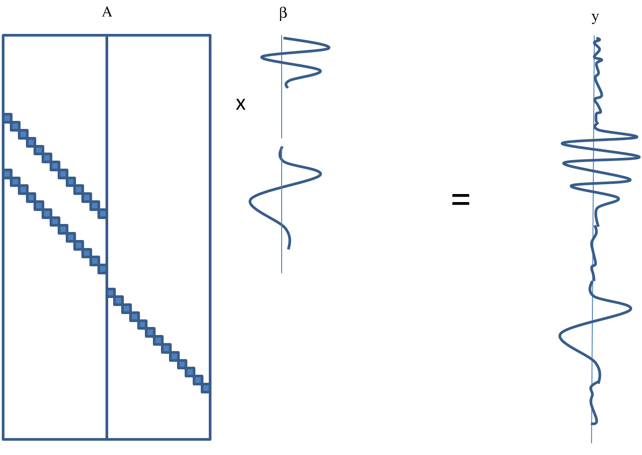
Regression Framework
β’= (Α^{Τ}Α)⁻¹ Α^{Τ}y

Slide 9
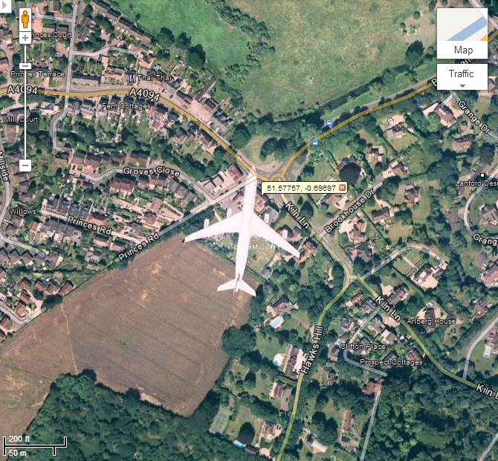
Rapid Serial Visual Presentation

Slide 10
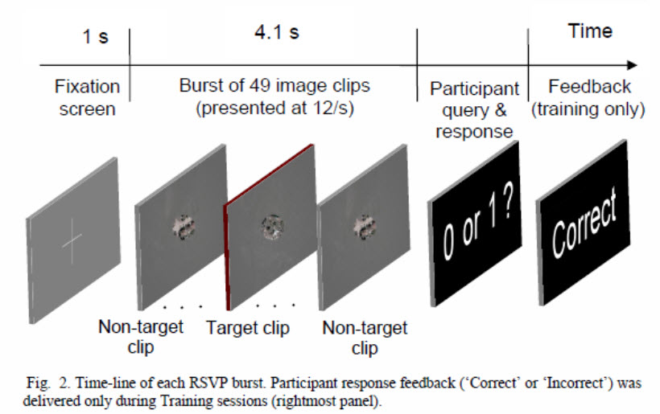
Experiment - RSVP

Slide 11
Event Type | Description
1 | Non-target frame
2 | Target frame (contains airplane)
4 | “No targets” response
5 | “One target” response
6 | Block start
16 | Start of trial
32 | “Correct” feedback given to participant
64 | “Incorrect” feedback given to participant
129 | Burst start

Slide 12
Analysis
Compute ERP and rERP for all 127 channels.
At each event, subtract the ERP and combined rERP estimates from original signal (noise).
Subtract variance of noise from variance of original signal (Reduction of Variance: AKA ROV or R² or Coefficient of Determination).

Slide 13
Comp 17– ERP & rERP Estimates

Slide 14
ERP & rERP R²

Slide 15
Conclusions
Regression better than averaging?
If there is systematic overlap with other ERPs, yes.
If there is no overlap, regression produces the same results as averaging.
ICA components show a higher concentration of ROV compared with channels for each method.

Slide 16
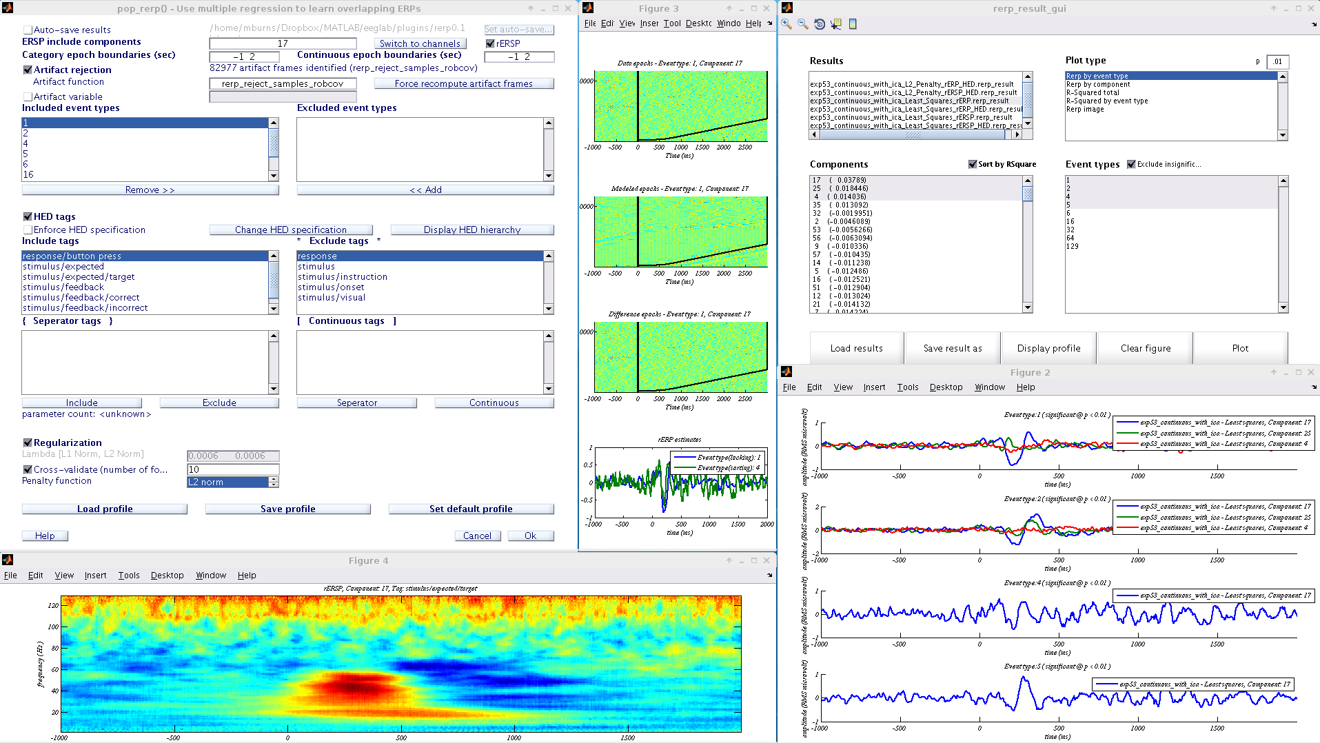
rERP Toolbox Overview

Slide 17
Logistics
download: github.com/mattb243/rERP
Will be available in plugin manager in the future
support: rerptoolbox@gmail.com
Bug reports
Subject “ADD” to receive updates on this project, new pubs, etc.
doc: http://sccn.ucsd.edu/wiki/EEGLAB/RERP

Slide 18
rERP

Slide 19
rERP

Slide 20
rERSP

Slide 21
rERPimage

Slide 22
Basic Design
EEG struct
RerpProfile class
pop_rerp function
RerpResult class

Slide 23
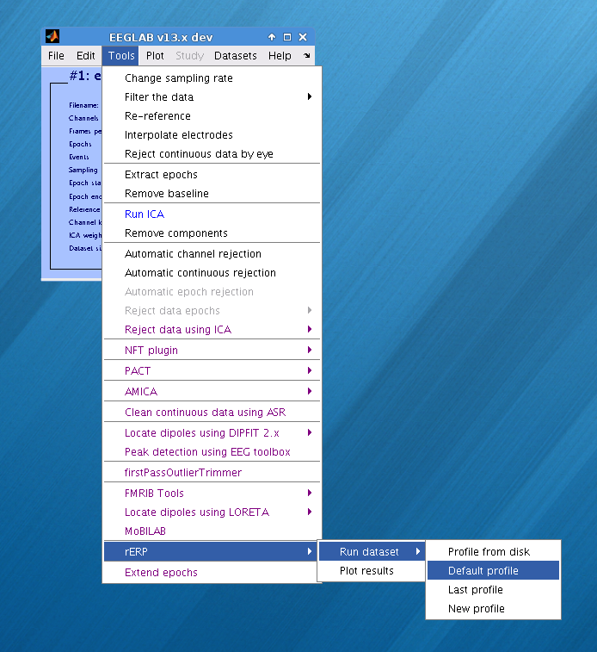
Profile: GUI
Get started quickly by using the EEGLAB GUI menu: Tools-> rERP-> Run Dataset-> New profile
To view and edit an existing profile: pop_rerp(EEG, profile, ‘force_gui’, 1);

Slide 24
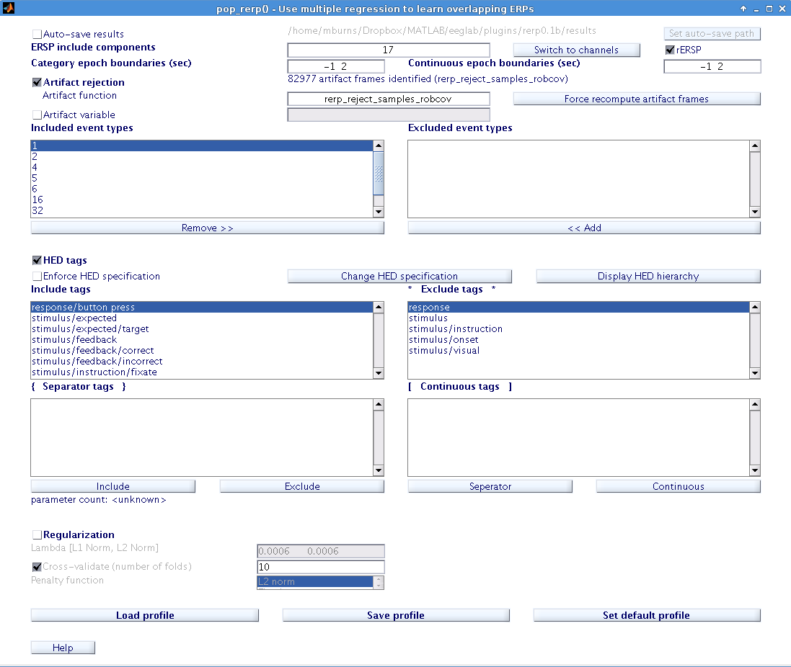
Profile: GUI

Slide 25
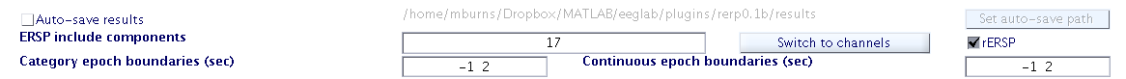
Profile: general settings
Choose channels or components
Choose rERP or rERSP (time-frequency)
Enable automatic result saving
Set epoch boundaries

Slide 26
Profile: artifact settings
Enable automatic artifact rejection
Enter the name of custom artifact function
or
Use a logical index artifact variable from the workspace.

Slide 27
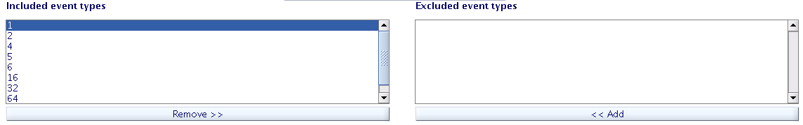
Profile: event types
Choose event types to be included in the regression framework.

Slide 28
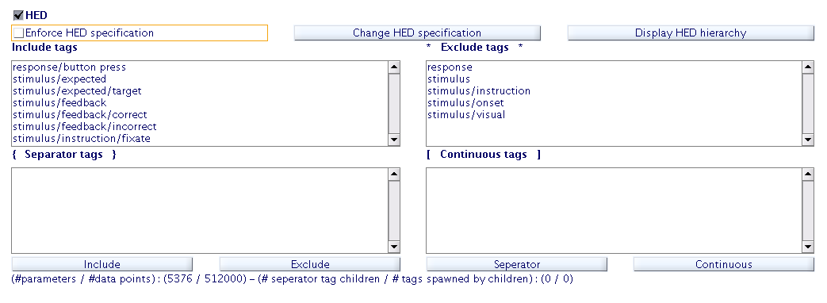
Profile: Hierarchical Event Description (HED) Tags
Enable and configure hierarchical regression
Hint: EEG struct must be tagged: ( i.e. EEG.event(i).hedTag = hedString; )

Slide 29
About HED Tags
Event type: Hed Tags
1: stimulus/visual
stimulus/expected
2: stimulus/visual
stimulus/expected/target
4: response/button press
32: stimulus/visual
stimulus/feedback/correct
64: stimulus/visual
stimulus/feedback/incorrect

Slide 30
Hierarchical Regression

Slide 31
Profile: HED Tags { Separator Tags }
Custom/Block/1
Custom/Block/2
Separator tag
Custom/Block
“Block 1”
“Block 2”

Slide 32
Profile: HED Tags [ Continuous Tags ]
Custom/Mag/5.2
Custom/Mag/3.25
Custom/Mag/1
Continuous Tag
Custom/Mag

Slide 33
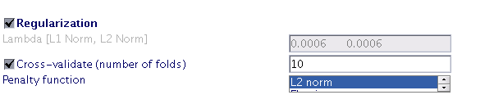
Profile: Regularization
Enable regularization (penalized regression)
If deselected, Ordinary Least Squares
Select penalty function
L2 Norm is fastest
Enable cross-validation grid search for λ
If deselected, must specify λ manually

Slide 34
Profile: File Operations
Load and examine other profiles from disk
Save the current profile for reuse with scripts
Change the default settings for new profiles
Run the analysis
Note: Last profile used is always saved in
rerp/profiles/last.rerp_profile

Slide 35
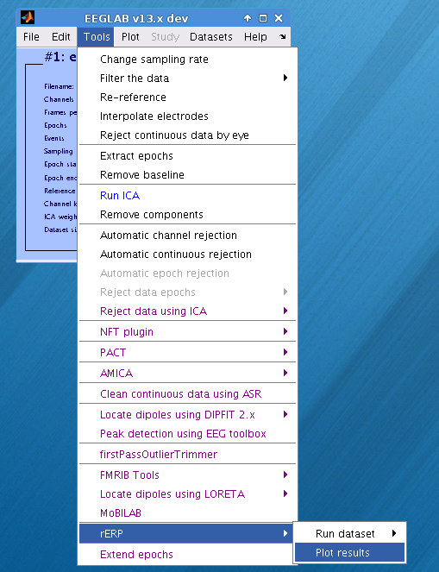
Result: GUI
Launch results GUI from EEGLAB or type rerp_results_gui at command line
If scripting, RerpResult objects must be saved to disk before viewing in GUI.

Slide 36
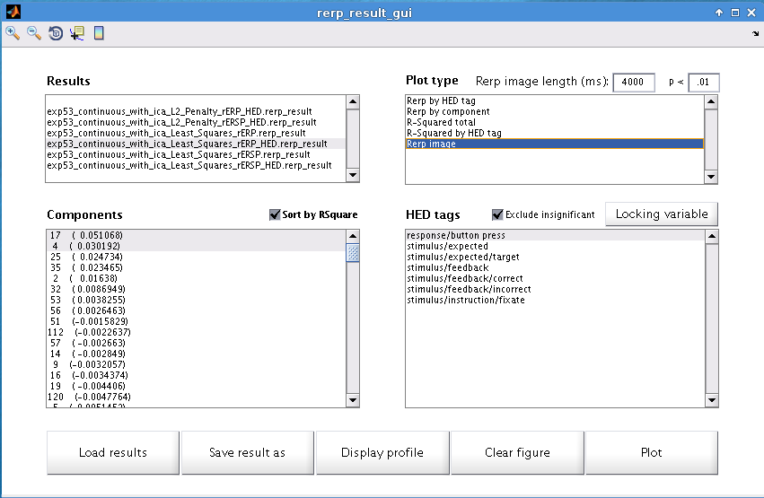
Result: GUI

Slide 37
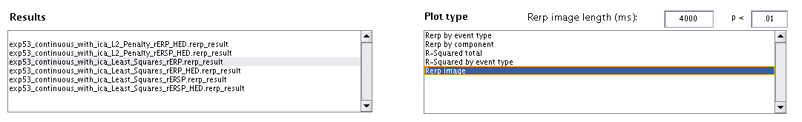
Result: Results List and Plot Type
Results list is populated from directory rerp/results and also from the path to the .set file if the ‘EEG’ argument is passed.
Type of plot depends on result
p-value threshold can be specified for statistics
Image length for rERPimage can be adjusted

Slide 38
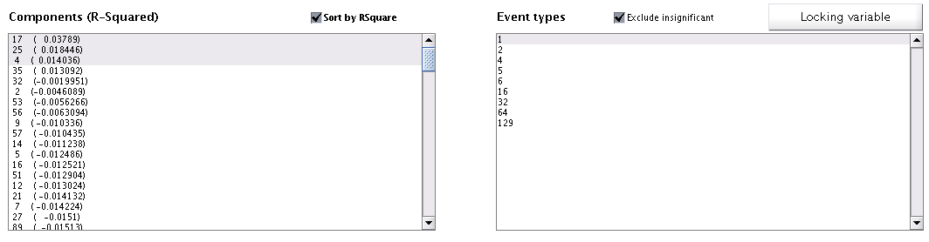
Result: Channels/ICs and Events/Tags
Multiple select of both Channels/ICs and Events/Tags is available for most plot types
Exclude insignificant rERP estimates based on p-value threshold of ttest of R² across folds
Cycle between Locking/Sorting variable for rERPimage

Slide 39
Result: Plotting and Publishing
Load other results from disk, resave them and view their profiles
Plot on same graph, possibly from different plot types and different Results
Right click on the axes or image to save only that graph

Slide 40
Questions ?

